Slide 1


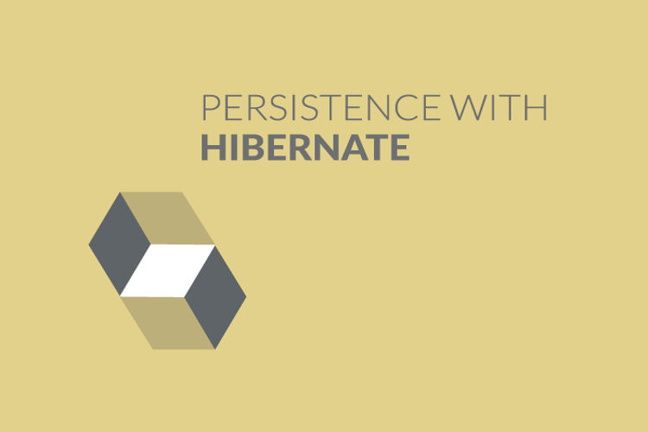
INTRODUCTION TO HIBERNATE
Chapter 1

Slide 2
Today’s Agenda
An Introduction To Hibernate
What Is Hibernate ?
What Is JDBC And What Are Problems With JDBC ?
What Is ORM ?
Advantages Of Hibernate
Why Should We Learn Hibernate In 2020?

Slide 3
What Is Hibernate ?
Hibernate is one of the most popular (ORM) tool in the world of Java.
The word ORM stands for Object/Relational Mapping
It is used in the data layer of our application.

Slide 4
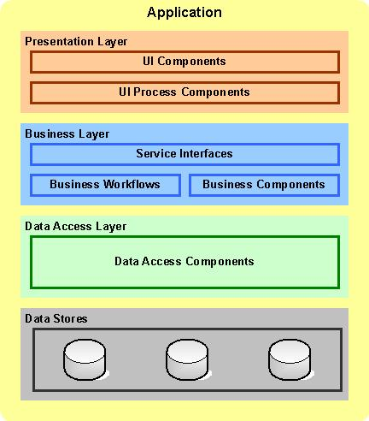
Application Layers
Hibernate works at this layer

Slide 5
What Is Hibernate Based Upon?
It works on the principles of JPA.
JPA stands for , Java Persistence API (JPA)
It is a specification which gives guidelines about how a developer can map, store, update and retrieve data from relational databases to Java objects and vice versa.
JPA itself is not a tool or framework; rather, it defines a set of concepts that can be implemented by any tool or framework.

Slide 6
Why Was Hibernate Developed ?
Hibernate has been mainly developed to resolve the problems a programmer faces with JDBC.
But before understanding what problems are with JDBC let’s first recall the basics of JDBC

Slide 7
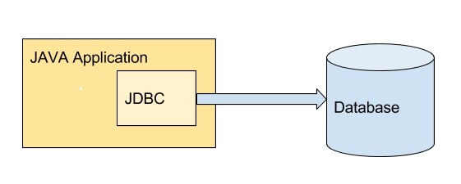
What Is JDBC ?
JDBC stands for Java Database Connectivity
It is an API that comes with JSE and enables a Java application to access the database using SQL

Slide 8
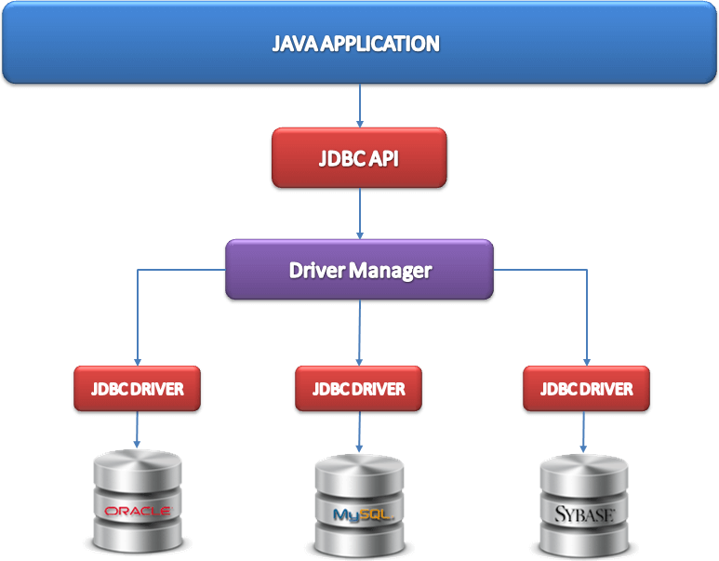
Steps In JDBC
Loads the driver
Opens a database connection
Sends SQL queries to database using a JDBC driver
Executes the queries to get the result set
When results are returned, then it processes the data
Finally, the connection is closed

Slide 9
Problems With JDBC
JDBC makes Java code tightly coupled to the database schema i.e any change in the database schema , like renaming a column effects JDBC written Java code.
Developer has to write a lot of boilerplate code like opening the connection , creating PreparedStatement , traversing through the records , closing the connection etc.

Slide 10
Problems With JDBC
In JDBC , our code raises SQLException which is a Checked Exception and thus it is compulsory for the programmer to either handle it or declare it to be thrown , even though the programmer doesn’t want to .
JDBC retrieves data in table format i.e in the row and column format and not in the form of objects directly. The developer has to then traverse through the ResultSet records and then set them into object attributes.

Slide 11
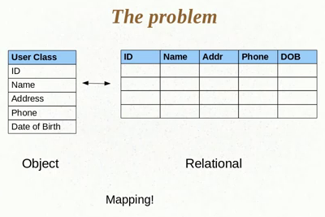
Problems With JDBC

Slide 12
An Inefficient Solution
To push or pull the tabular data into objects and vice versa a Java developer has to convert his object into table’s row .
This is done by pulling each attribute’s value and storing it in the column of the table.

Slide 13
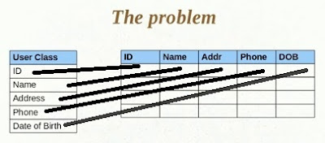
An Inefficient Solution

Slide 14
The Problems & Solution
Although it works but the process is very difficult and has following drawbacks:
Mapping data members to columns
Handling data types
Managing changes to object state

Slide 15
Problems With JDBC
JDBC , retrieves the data from the database in the form of ResultSets , but these ResultSet objects are not Serializable . That is , we cannot send them over the network directly. So we need to convert them to other types before transmitting them over the network .
JDBC has no proper support for Transaction Management. It only can manage local transaction but not global transaction management

Slide 16
Problems With JDBC
JDBC , doesn’t allow us to enjoy Inheritance , Polymorphism or Composition support in our code because we cannot pass Java Objects directly to SQL queries
The solution to all these problems is an ORM tool i.e. Hibernate

Slide 17
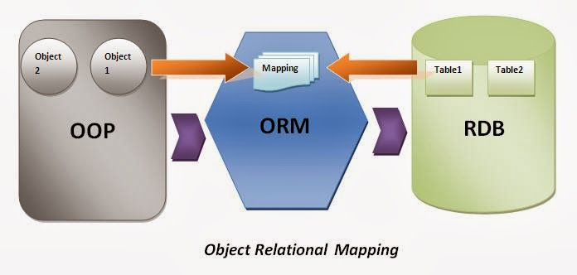
What Is An ORM?
ORM is a software tool that provides a simple API for storing and retrieving Java objects directly from database.
In simple words it is the process of mapping tables to class objects, so that data transactions could be easier.

Slide 18
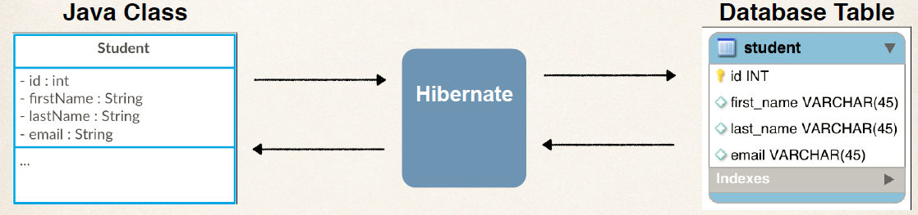
What Does An ORM Do ?
ORM maintains a connection between an object and relational database.
It maps (saves) an object state to database column.

Slide 19
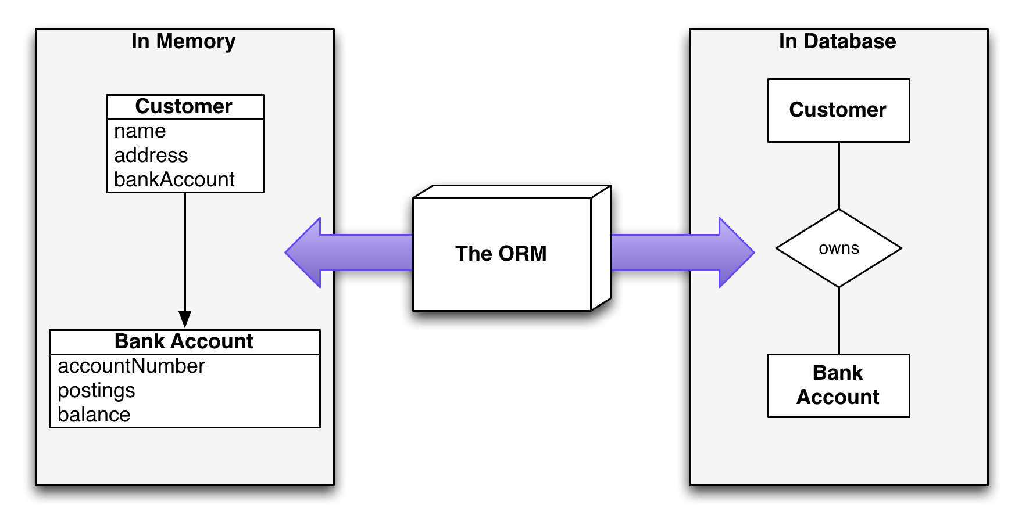
What Does An ORM Do ?
Apart from mapping , an ORM can also help a programmer maintain associations between 2 objects and reflect them as relationships in 2 tables

Slide 20
Top 12 Features Of Hibernate
Free & Open Source
We can download and use Hibernate without paying any licensing fee . Moreover we also can download the full source code of Hibernate while installing it
Light Weight
Hibernate software is distributed as a zip file and has a very small size which is around 65 MB
To use Hibernate , we just need JDK/JVM and Hibernate libraries
It doesn’t require any heavy wieight containers or web/application servers

Slide 21
Top 12 Features Of Hibernate
Portable
Hibernate allows us to develop persistence logic using Java objects and not SQL queries , so we can easily migrate from one DB to another DB without changing our Java code
Supports Non Invasive Programming
Hibernate doesn’t force us to extend any technology specific class or implement any specific interface while developing Persistence classes
So we can easily move our Java classes from one framework to another and this is called Non Invasive programming
Frameworks which support this are Hibernate , Spring , Struts 2.x etc

Slide 22
Top 12 Features Of Hibernate
Reduces Programmer’s Efforts
Since Hibernate easily maps Java classes to database tables and Java data types to SQL types, it reduces almost 95% efforts of programmer.
Supports Inheritance, Association and Collections
In Hibernate if we save the derived class object, then it’s base class object will also be automatically stored into the database.
It supports relationships like One to One , One to Many etc
It supports Java Collections like List, Set, Map

Slide 23
Top 12 Features Of Hibernate
No Checked Exceptions
In JDBC all exceptions are Checked Exceptions, so we must write code in try, catch and throws, but in Hibernate we only have UnChecked exceptions, so no need to compulsorily write try, catch or throws.
Special Note:
Actually in hibernate we have a translator which converts Checked Exceptions to Un-checked Exceptions

Slide 24
Top 12 Features Of Hibernate
Automatic Primary Key Generation
Hibernate has capability to generate Primary Keys automatically while we are storing the records into database
Database Independent Query Language
Hibernate has its own query language called HQL, i.e Hibernate Query Language which is database independent ,so if we change the database, then also our application will work as HQL is database independent

Slide 25
Top 12 Features Of Hibernate
Automatic Table Creation
When we insert a record using JDBC and suppose the table is not present in the database then JDBC will raise an error “table does not exist”, and will throw exception. But in case of Hibernate, if table is not found then it will create the table for us.
Supports Caching
Hibernate supports caching mechanism and due to this the number of round trips between an application and the database will be reduced which will automatically increase application performance

Slide 26
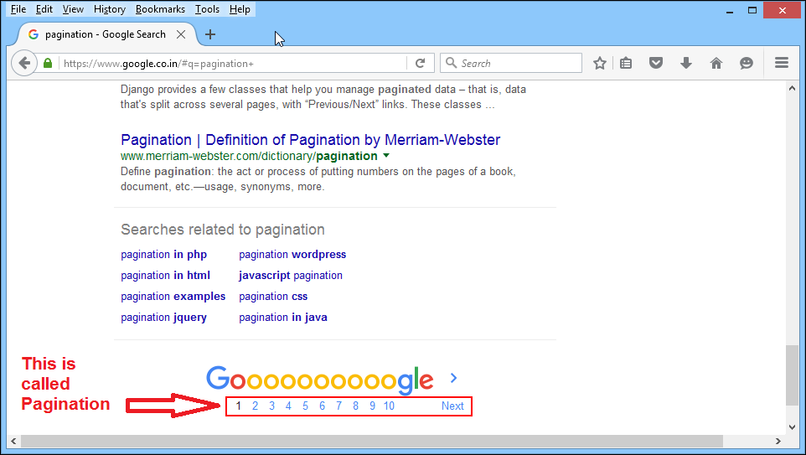
Top 12 Features Of Hibernate
Supports Pagination
Hibernate has built-in support for Pagination which is the process of dividing a large amount of content to be presented on the UI in chunks.

Slide 27
Disadvantages Of Hibernate
There is only 1 disadvantage of Hibernate as compared with JDBC which is that it is slower than JDBC.
This is because when Hibernate loads ,it analyzes all entities and does a lot of pre-caching .
This can take about 5-10-15 seconds for the application to start.

Slide 28
Disadvantages Of Hibernate
But we would require a very large application before we start to notice an impact from that.
And, many large applications are indeed using Hibernate successfully

Slide 29

History Of Hibernate
Created by Gavin King in 2001.
Later in 2003 , Red Hat hired
lead hibernate developers and
framed hibernate community for it’s
further development.
As of now it’s latest stable version is Hibernate 5.4.15 released on
30th-April-2020 and preview release is Hibernate 6.0.0.
The official site for hibernate is hibernate.org.

Slide 30
Alternates To Hibernate
Framework/Tool | Company
iBatis | Apache
TopLink | Oracle
EclipseLink | Eclipse
OJB | Apache
Spring JDBC, Spring ORM , Spring Data | Spring

Slide 31
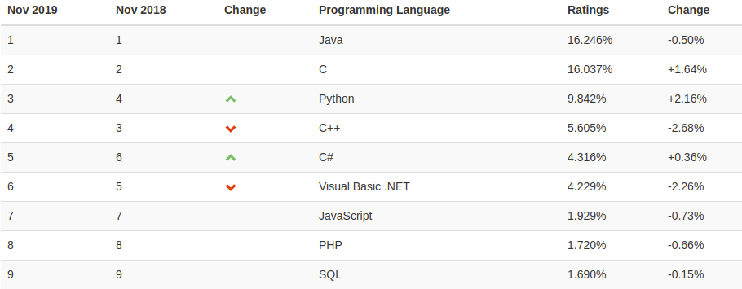
Why Should We Learn Hibernate In 2020 ?
We are heading towards end of 2020 and you can see that Java is still one of the most popular programming languages in the world.
https://towardsdatascience.com/9-top-java-frameworks-for-2020-1cc9d3c21f4c

Slide 32

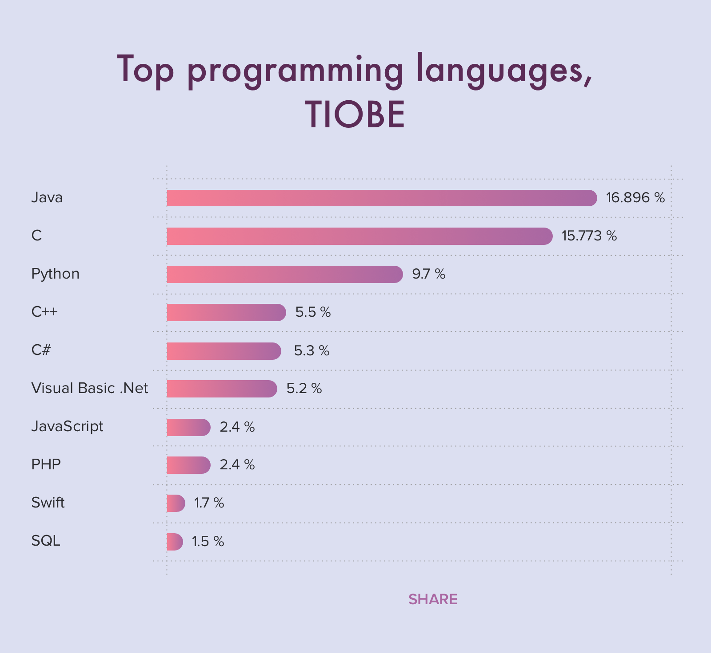
Where Java Stands Today ?
https://www.cleveroad.com/blog/programming-languages-ranking

Slide 33
Why Should We Learn Hibernate In 2020 ?
Moreover, there are various frameworks that have been designed to make coding in Java easy and faster.
So , if we use a popular Java framework, then we can focus more on writing the business logic of our app instead of writing the fundamental functions such as making database connections or handling exceptions.

Slide 34
Why Should We Learn Hibernate In 2020 ?
And Hibernate is 2nd most popular framework after Spring that every Java developer should learn because most of the Java applications we will work with will interact with a database, and it's excruciating to deal with a database in Java using JDBC without a proper framework like Hibernate.
https://towardsdatascience.com/9-top-java-frameworks-for-2020-1cc9d3c21f4c
https://www.expertsfromindia.com/tech-talk/software-development/how-to-become-a-best-java-developer-in-2020.html

Slide 35
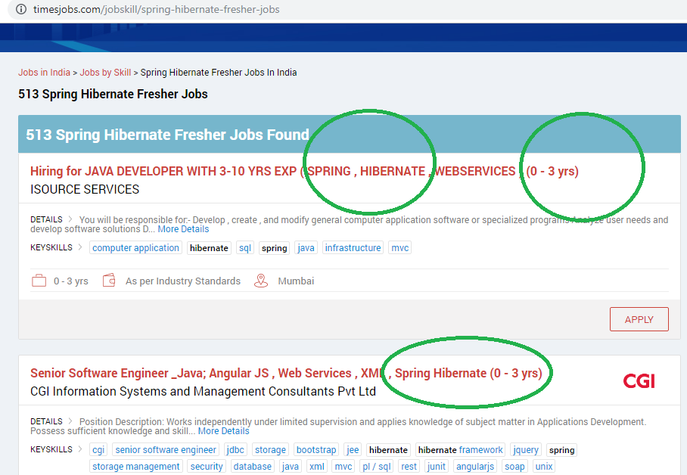
Job Market

Slide 36
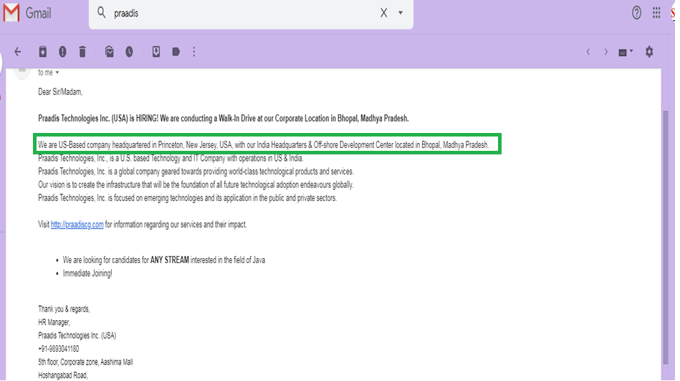
Mail To SCA

Slide 37
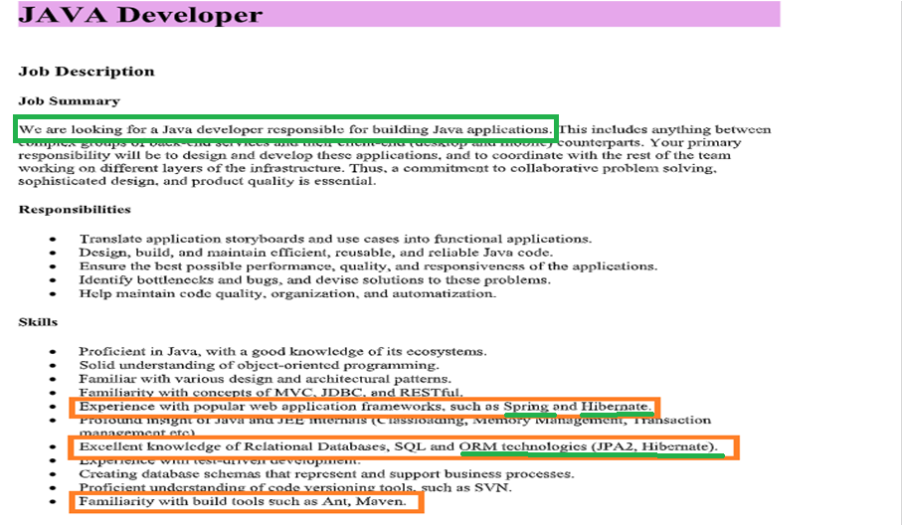
Mail To SCA

